Slide 1
H4X - Lets Hack!

Slide 2
Microcontrollers (ESP8266)

Slide 3

whoami
Christo Goosen

Slide 4
Whoami | grep disclaimer
I am not a engineer or a embedded/microcontroller expert. I tinker with devices and tech for fun and share what I have learnt through talks. Correct me if I am wrong and ask questions whenever you feel like you are unsure…..

Slide 5
Whoami | grep details
ME
Chief Technology Officer at CTRL Technologies
Studying: MSC Information Security
Ctrl Tech: Insurance Tech Company
Website: takectrl.co.za
Previous:
Python Dev
DevOPS
Dev/QA in systems performance
OWASP Cape Town
Open Web Application Security Project.
Non profit for advancing security in web applications and other.
Regular Meetups, all welcome !
https://www.owasp.org/index.php/Cape_Town
http://www.meetup.com/OWASP-Cape-Town-Chapter-Meetup/

Slide 6
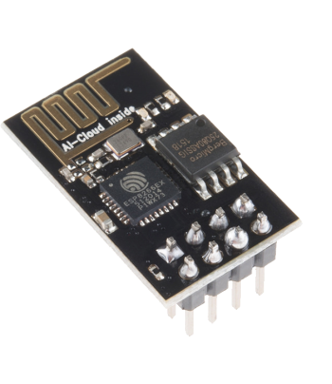
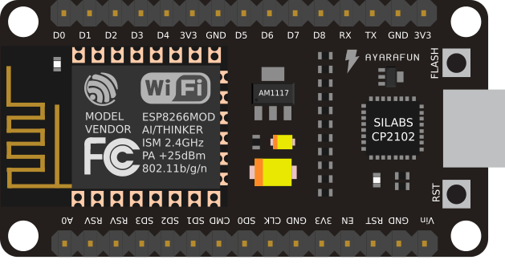
ESP8266
1
Let’s start with the ESP8266

Slide 7
ESP8266
32-bit RISC CPU: Tensilica Xtensa LX106 running at 80 MHz*
64 KiB of instruction RAM, 96 KiB of data RAM
External QSPI flash - 512 KiB to 4 MiB* (up to 16 MiB is supported)
IEEE 802.11 b/g/n Wi-Fi
Integrated TR switch, balun, LNA, power amplifier and matching network
WEP or WPA/WPA2 authentication, or open networks
16 GPIO pins
SPI, I²C,
I²S interfaces with DMA (sharing pins with GPIO)
UART on dedicated pins, plus a transmit-only UART can be enabled on GPIO2
1 10-bit ADC
1

Slide 8
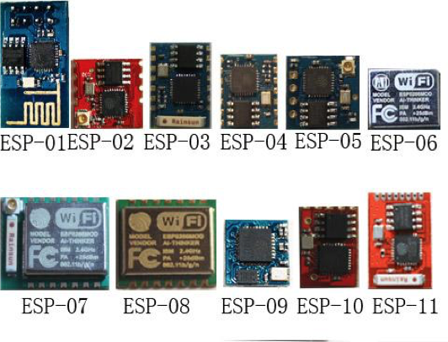
ESP8266 Internals (ESP-12)

Slide 9
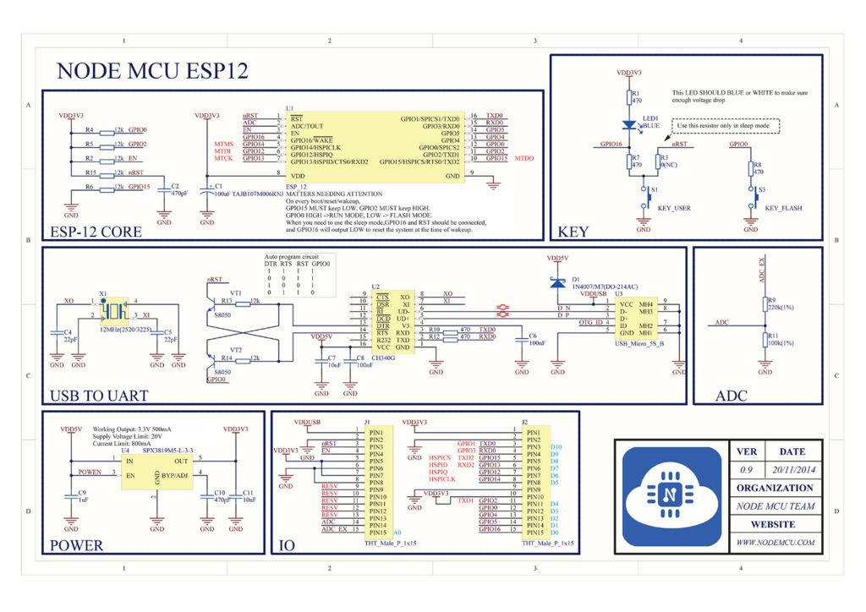
ESP8266 Internals (ESP-12)

Slide 10
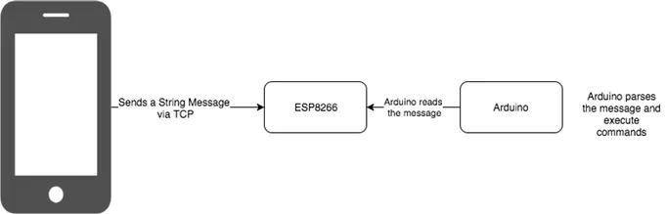
ESP8266 & Arduino

Slide 11
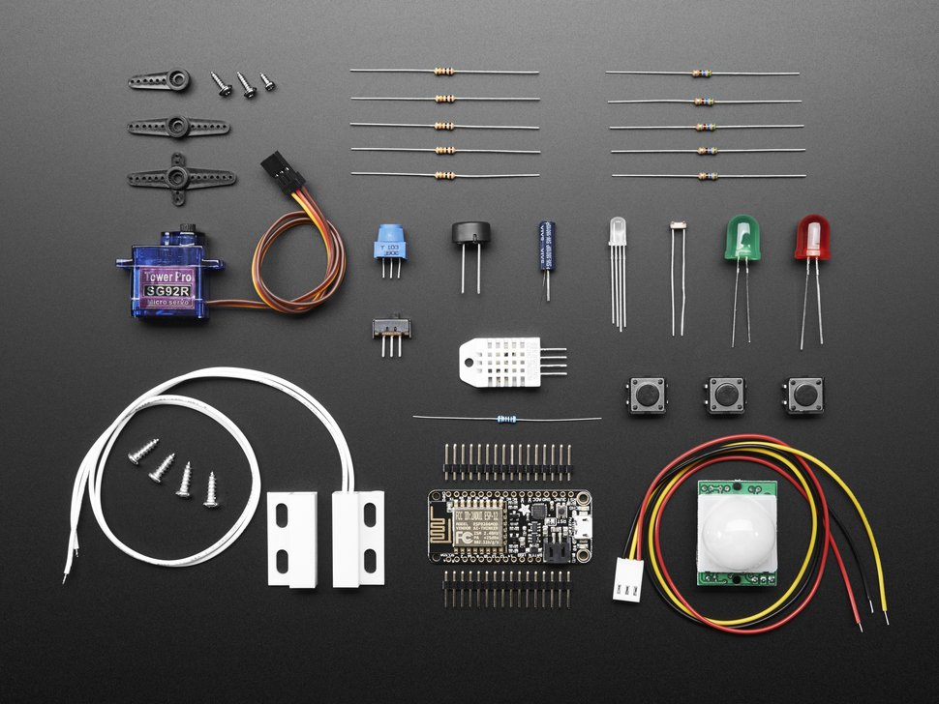
ESP8266 & sensors/devices
https://www.adafruit.com/product/2680

Slide 12
Programming the ESP8266
2
Programming languages, toolchains, etc.

Slide 13
Languages/Frameworks
Trusty old C
Micropython
Lua (NodeMCU)
Javascript
Mongoose OS
Espruino (Javascript)
Arduino (C++
ESP8266 BASIC
Etc etc etc)

Slide 14
Micropython
Micropython:
WARNING: The port is experimental and many APIs are subject to change.
Supported features include:
REPL (Python prompt) over UART0.
Garbage collector, exceptions.
Unicode support.
Builtin modules: gc, array, collections, io, struct, sys, esp, network, many more.
Arbitrary-precision long integers and 30-bit precision floats.
WiFi support.

Slide 15
Micropython
Features continued:
Sockets using modlwip.
GPIO and bit-banging I2C, SPI support.
1-Wire and WS2812 (aka Neopixel) protocols support.
Internal filesystem using the flash.
WebREPL over WiFi from a browser (clients at https://github.com/micropython/webrepl).
Modules for HTTP, MQTT, many other formats and protocols via https://github.com/micropython/micropython-lib .
Work-in-progress documentation is available at http://docs.micropython.org/en/latest/esp8266/ .

Slide 16
Micropython - Docs
https://docs.micropython.org/en/latest/esp8266/esp8266/tutorial/repl.html
https://micropython.org/webrepl/

Slide 17
WIFI/IOT/Smart Devices
3
Hello world!

Slide 18
Make something smart
5

Slide 19
Get Started!
Adafruit
https://learn.adafruit.com/category/internet-of-things-iot
instructables
http://www.instructables.com/howto/esp8266/
Hackaday
https://hackaday.com/tag/esp8266/
Aliexpress
https://www.aliexpress.com/wholesale?catId=0&initiative_id=SB_20180406221016&SearchText=esp8266
Intro talk youtube
https://www.youtube.com/watch?v=srrf-25_Ytw
Follow these geniuses
Twitter
@elasticninja
@AndrewMohawk
https://robynfarah.com/
https://www.facebook.com/groups/ArduinoCapeTown/about/

Slide 20
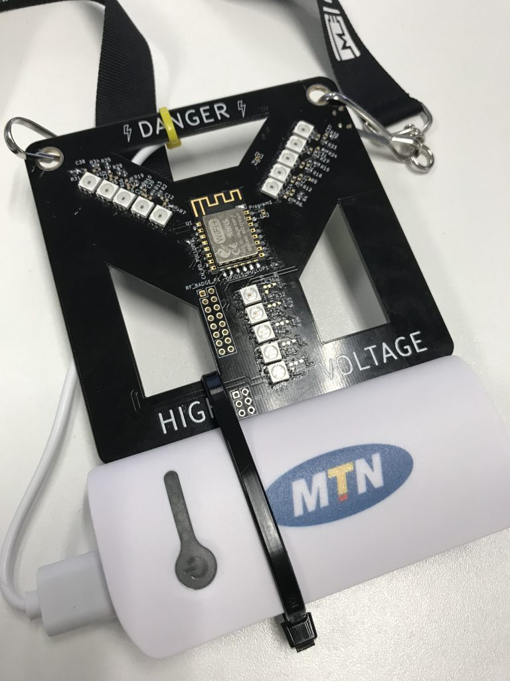
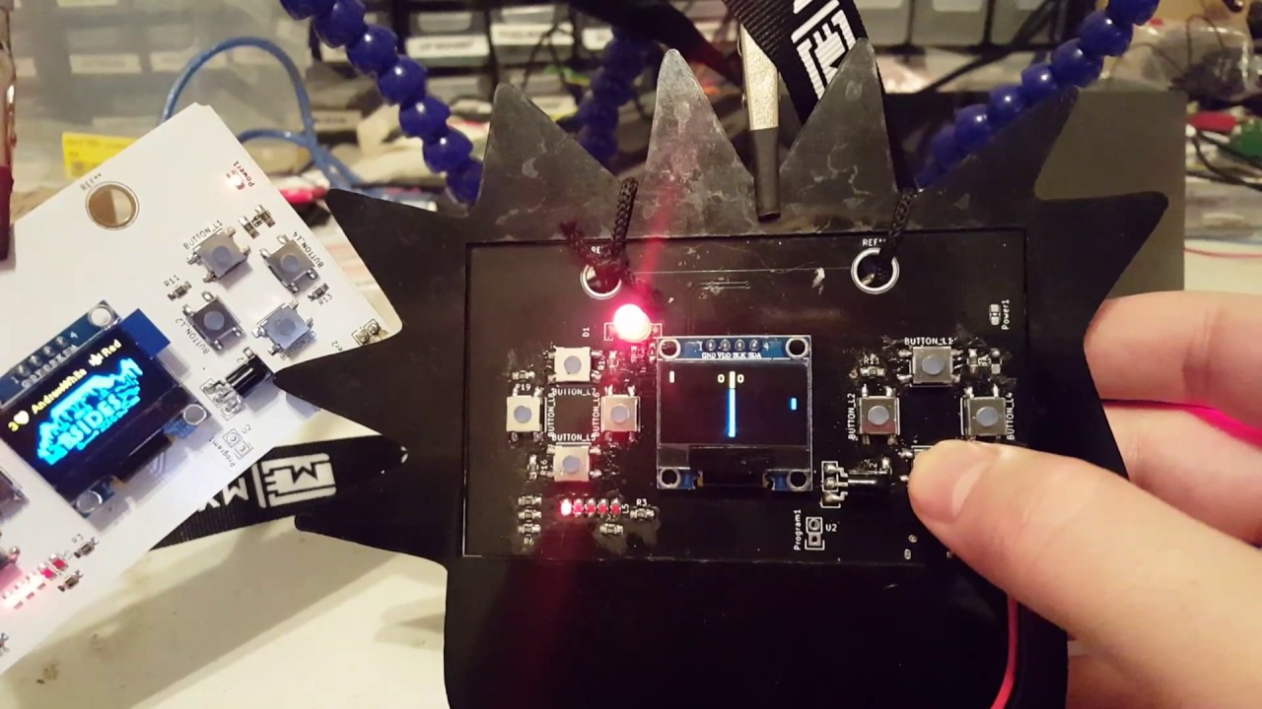
BSIDES CPT 2016 & 2017

Slide 21
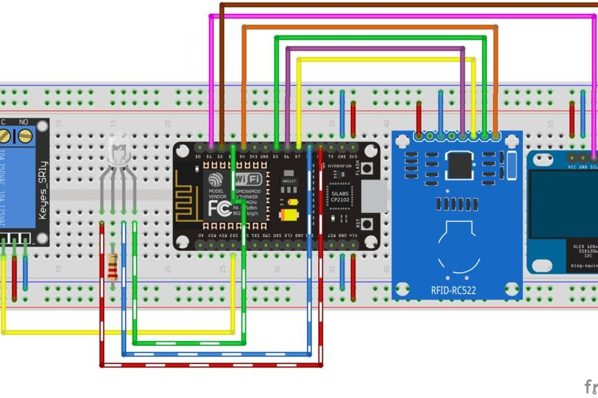
Access Control Wifi + RFID

Slide 22
Security
4
Insecurity of Things

Slide 23
Low Level device Access & Wifi
Deauth attacks:
https://hackernoon.com/deauthentication-attack-and-other-wifi-hacks-using-an-esp8266-module-14f9142b063d
https://github.com/spacehuhn/esp8266_deauther
Wifi Sniffing:
https://www.hackster.io/rayburne/esp8266-mini-sniff-f6b93a

Slide 24
WIFI KRACK
Fixing Krack:
https://github.com/esp8266/Arduino/issues/3725
https://github.com/nodemcu/nodemcu-firmware/issues/2138
Smoking out KRACK in remote places:
http://www.instructables.com/id/ESP8266-OTA-Tutorial-Over-the-Air-Update/

Slide 25

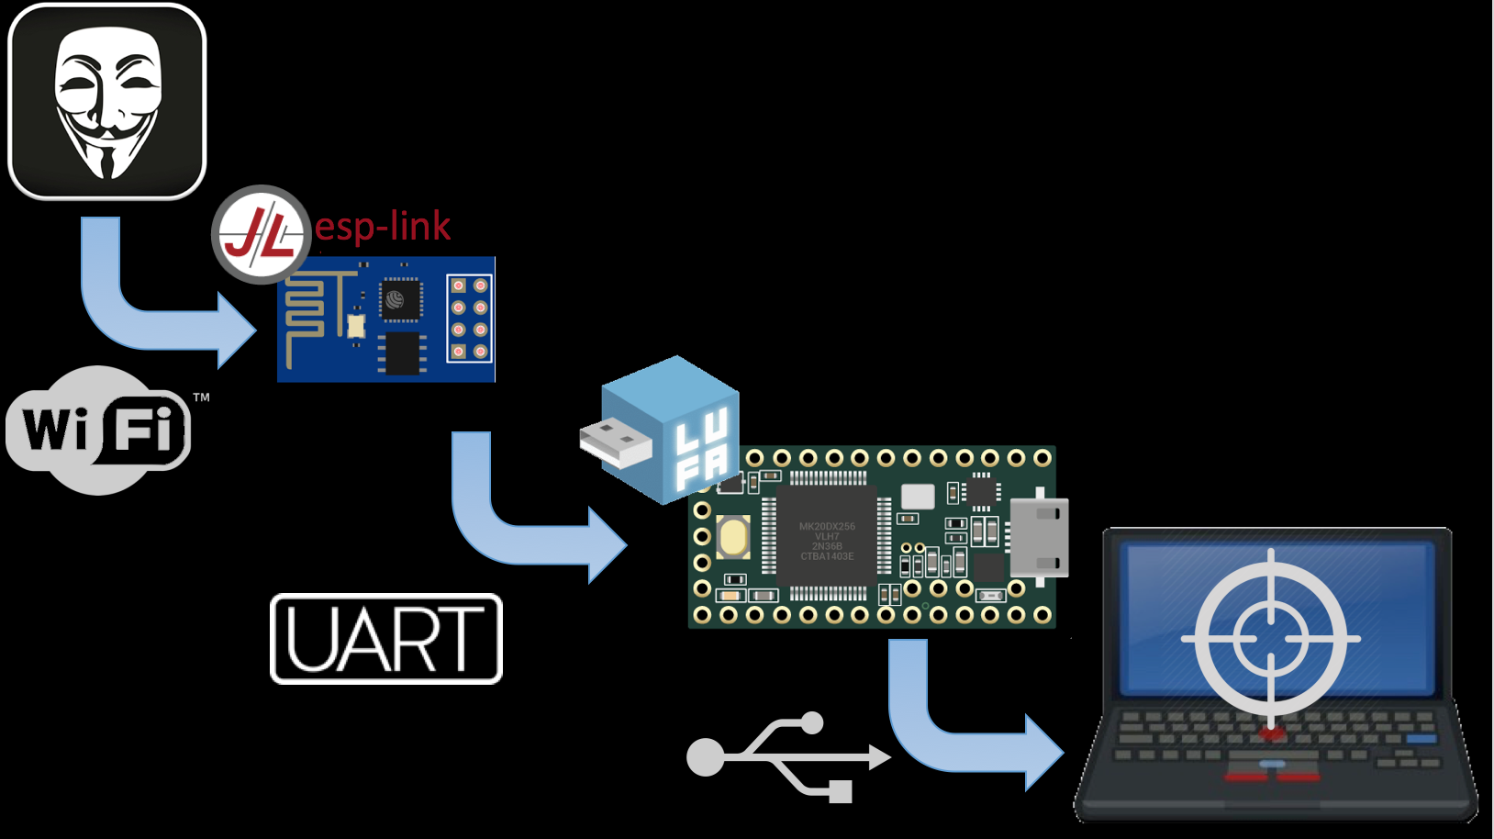
SensePost badUSB
https://github.com/sensepost/USaBUSe

Slide 26


Slide 27
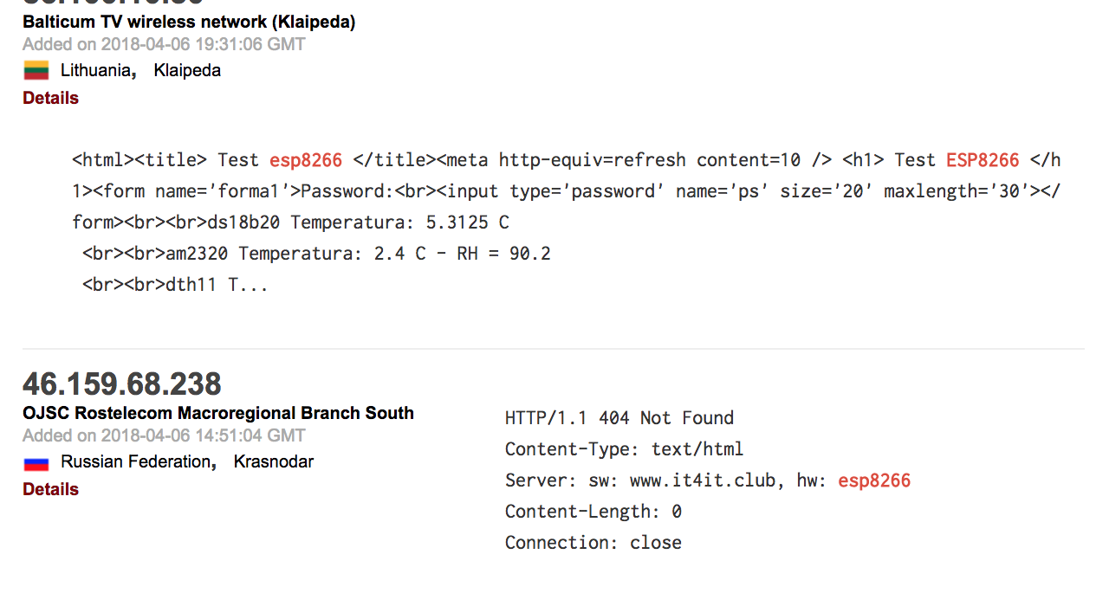

Slide 28
Thanks!
Any questions?
You can find me at:
@owasp_cpt
christo<at>christogoosen.co.za
christo.goosen<at>takectrl.co.za
christo.goosen<at>owasp.org
github.com/c-goosen

Slide 29
Sources
ESP8266:
https://en.wikipedia.org/wiki/ESP8266
https://github.com/esp8266/Arduino/blob/master/doc/esp8266wifi/client-secure-examples.rst
IOT Development:
https://opensource.com/article/17/3/mongoose-os-iot-development
https://platformio.org/platforms/espressif8266
https://mongoose-os.com/software.html
https://mongoose-os.com/docs/reference/api.html
Programming Languages:
Micropython
http://docs.micropython.org/en/latest/pyboard/library/machine.Pin.html
NodeMCU
http://www.nodemcu.com/index_en.html
Arduino
https://github.com/esp8266/Arduino

Slide 30
Sources
Projects, libraries and examples:
https://github.com/esp8266/Arduino/blob/master/doc/esp8266wifi/client-secure-examples.rst
http://www.techparva.com/index.php/2017/09/28/interfacing-mfrc522-rfid-card-esp8266/
https://github.com/sensepost/USaBUSe

